Slide 1





PAYSWIFT GHANA: DATA-DRIVEN GROWTH STRATEGY
RECOMMENDATIONS FOR PRODUCT ENHANCEMENT AND CUSTOMER ENGAGEMENT
APRIL 2025
Presented by: Oliver Acquah ,Data Analyst

Slide 2






INTRODUCTION
PaySwift Ghana is a growing fintech company offering:
Mobile payment solutions
Micro-loans & credit scoring
Personal finance management tools
Despite its potential, the company faces key challenges:
Low adoption of certain features
High loan default rates
Rising customer churn
This analysis explores user behavior, default risk, and churn patterns to deliver data-driven recommendations for improving engagement, retention, and financial performance.
Key Question: How can we use data to increase feature adoption, reduce defaults, and improve retention?

Slide 3




OBJECTIVES OF ANALYSIS
KEY METRICS
Understand user behavior around feature usage and transactions
Analyze repayment patterns and default risk
Churn Rate: 34%
High Risk Customers: 48%
Low Risk Customers: 34%
Repayment Status
On-Time: 34%
Late Payment: 34%
Defaulted: 32%
Examine churn causes and trends
Provide actionable recommendations backed by data

Slide 4

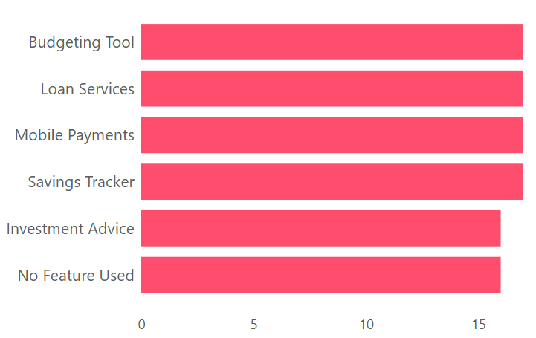



FEATURE USAGE INSIGHTS
Most Used Features: Budgeting Tool, Mobile Payments, Investment Advice
Least Used / Low Engagement: Loan Services, No Feature Used
Users engaging with investment and budgeting tools show higher transaction activity

Slide 5
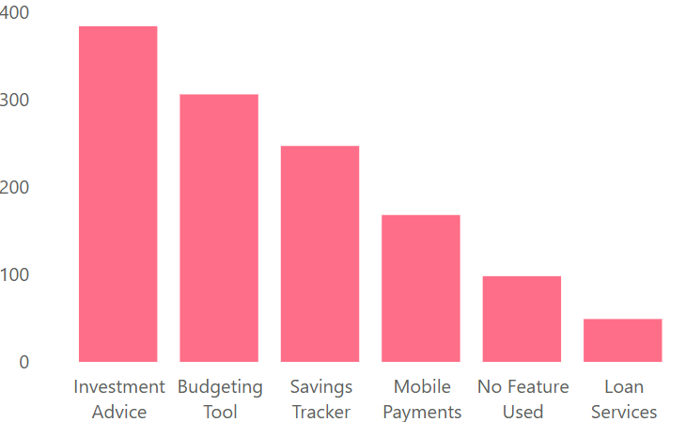
MONTHLY TRANSACTIONS BY FEATURE
Investment Advice: Highest average monthly activity
Loan Services & No Feature Used: Lowest activity
Clear correlation between feature engagement and transaction volume
2022

Slide 6
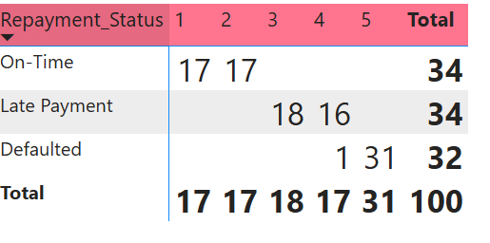
REPAYMENT & DEFAULT RISK ANALYSIS
Users with "On-Time" repayments have the lowest average risk (1.5)
Users with "Defaulted" status have the highest average risk (~5)
Loan Services users show both high default risk and high churn

Slide 7
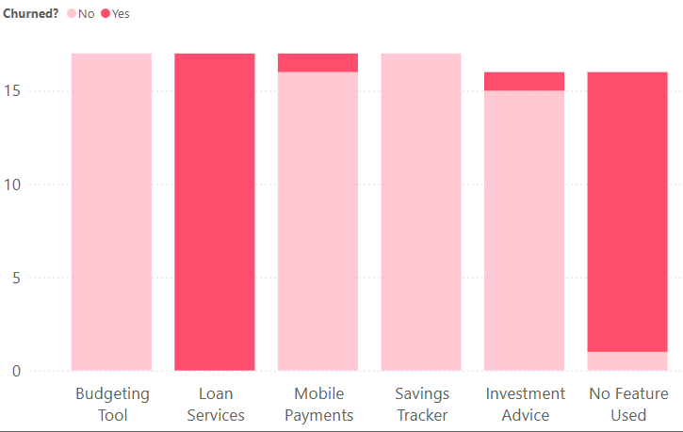
100% churn for users who used Loan Services
93.75% churn among users with "No Feature Used"
Features like Budgeting Tool and Savings Tracker have 0% churn
ChURN TRENDS
Possible Reasons for Churn
Low Engagement: Users who do not use any features or use underperforming ones (like Loan Services) might not find sufficient value in the offerings. Loan Stress: The high default risk and potential financial strain observed (especially in the Defaulted cohort) can drive dissatisfaction and eventually lead to churn.
Mismatch in Offerings: There might be a misalignment between the product offerings and customer needs for certain segments, possibly in terms of ease of use, clarity, or perceived benefits

Slide 8

BUSINESS INSIGHTS
Promote cross-usage of tools (e.g., users of Budgeting Tool to try Savings Tracker)
Tailor onboarding and in-app nudges for low-usage segments
Build trust through education and proactive financial support
20%
10%
25%
30%

Slide 9
RECOMMENDATIONS
Improve Loan Services: clarity, flexibility, onboarding help
Use risk scores + behavior to trigger alerts and interventions
Target “No Feature Used” users with incentives
Promote cross-feature engagement
Provide personalized onboarding, financial tips, and smart notifications
Build a feedback loop and educate users to reduce defaults
20%
10%
25%
30%

Slide 10
UX/UI & PRODUCT SUGGESTIONS
Guided tutorials during onboarding
Contextual prompts ("Have you tried...?")
Smart notifications for loan reminders, unused features, and financial health tips
AI-based budgeting and repayment suggestions
20%
10%
25%
30%

Slide 11
PROJECTED IMPACT
40% reduction in churn
25% increase in feature adoption
30% drop in default rate
Enhanced user satisfaction and lifetime value
20%
10%
25%
30%

Slide 12
CONCLUSION
Data reveals clear opportunities to improve engagement, reduce defaults, and retain users.
Focusing on user segmentation, proactive communication, and feature optimization will drive measurable business outcomes.
With the right UX and product interventions, PaySwift can foster long-term loyalty and financial wellbeing for its customers.
20%
10%
25%
30%

Slide 13

payswift
THAN YOU

